Slide 1
Defect Detection Using Active contour method
N. Pranay manikanta 160040613
Salaka Mukesh Kumar 160040794

Slide 2
Abstract
Our Paper is based on the non-destructive testing (NDT) method to inspect industrial equipment's quality and anomalies by using infrared thermography techniques to identify defects in an artifact such as fluid materials and any disruption or sub-surface fractures by using different thermography techniques to recognize defects. Here we discuss various types of thermography techniques, like pulse thermography, lock-in thermography, pulse width thermography, quadratic frequency modulated thermal wave thermography. And when we come to the post-processing which is an image segmentation process in this they are ‘n’ no of technique are there in those technique we use active contour image segmentation technique. Which play a usage role in our paper in order to identify the particular defect area. In the given artifact.

Slide 3
Content:
Introduction to thermography
Pre-processing and postprocessing
Segmentation methods
Segmentation Results

Slide 4
Why thermography ?
Active thermography has been proven to be a reliable tool to detect defect of internal cracks. A great deal of research work has been carried out to implement qualitative and quantitative analysis. One of the most popular applications in thermography is the capability in detecting internal cracks in various structures. Most of the cracks are invisible from external view. However, ignoring these cracks will ultimately cause serious consequence as they may continuously deteriorating and finally fatal breakdown occurred. To reveal these invisible cracks, active thermography has been proposed to predict, detect and quantify the cracks. The advantages of active thermography include non-contact and non-intrusive inspection, possibility in detecting internal cracks and a fast and portable method.
Temperature variation is present in almost everything in our daily life, this is one of the main advantage to go for thermography. Subsurface defects can be more analysed in infrared thermography. Sometimes we go for heating the substance to get heat patterns and varying it to more analyse them.

Slide 5
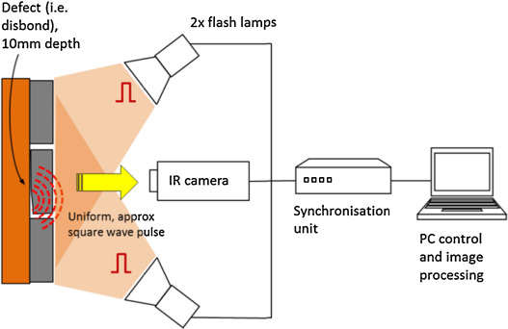
Image Acquisition

Slide 6
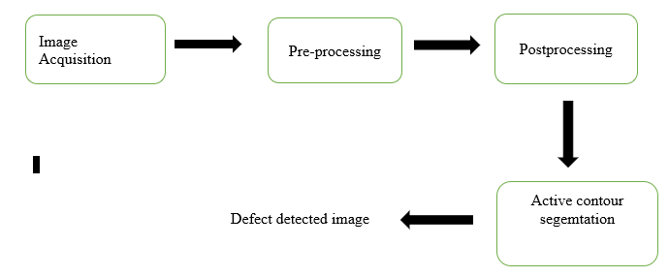
Steps to performed

Slide 7
Pre-processing
A process of heating the body
Methods :-
1.pulse thermography
2.lock in thermography
3.pulse phase thermography
4.Quadtratic frequency modulated thermal wave

Slide 8
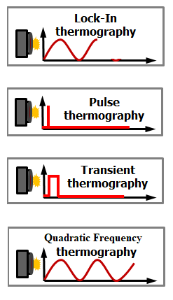
Pre-processing techniques

Slide 9
Segmentation
The Image segmentation is referred to as one of the most important processes of image processing. Image segmentation is the technique of dividing or partitioning an image into parts, called segments.
It is mostly useful for applications like image compression or object recognition, because for these types of applications, it is inefficient to process the whole image. So, image segmentation is used to segment the parts from image for further processing.

Slide 10
Image segmentation techniques
There exist several image segmentation techniques, which partition the image into several parts based on certain image features like pixel intensity value, color, texture, etc.
some of the segmentation method that we referred:-
1. Thresholding Method
2. Edge Based Segmentation Method
3. Region Based Segmentation Method
4. Active contour segmentation

Slide 11
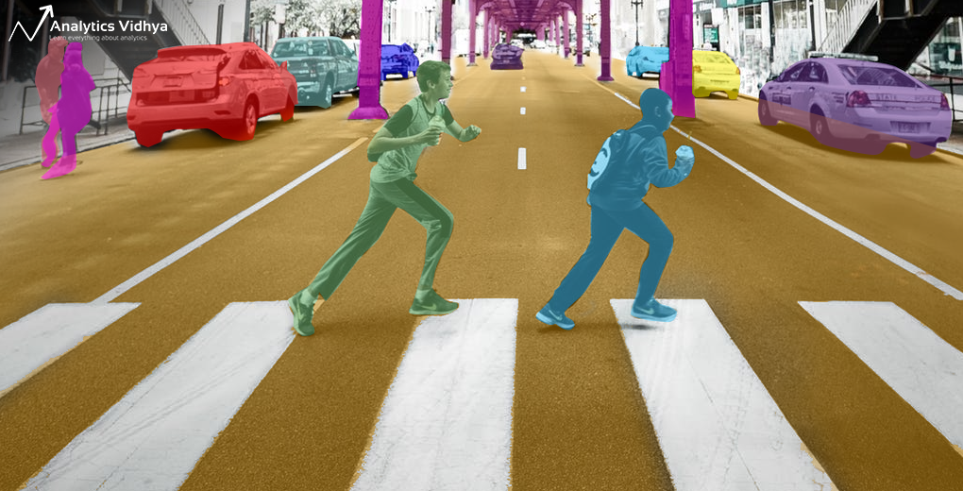
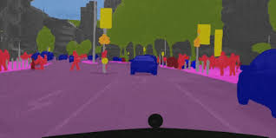
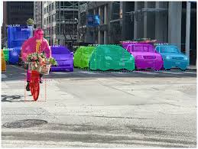
Examples:

Slide 12
Thresholding segmentation method
Thresholding methods are the simplest methods for image segmentation. These methods divide the image pixels with respect to their intensity level. These methods are used over images having lighter objects than background.
The selection of these methods can be manual or automatic i.e. can be based on prior knowledge or information of image features. There are basically three types of thresholding
1. Global Thresholding
2. Variable Thresholding
3. Multiple Thresholding

Slide 13
Global Thresholding: This is done by using any appropriate threshold value/T. This value of T will be constant for whole image. On the basis of T the output image q(x,y) can be obtained from original image p(x,y)
Variable Thresholding: In this type of thresholding, the value of T can vary over the image. This can further be of two types:
Local Threshold: In this the value of T depends upon the neighbourhood x & y
Adaptive Threshold: The value of T is a function of x and y.
Multiple Thresholding: In this type of thresholding, there are multiple threshold values like T0 and T1.

Slide 14
Edge Based Segmentation Method
The edge detection techniques are well developed techniques of image processing on their own.
The edge based segmentation methods are based on the rapid change of intensity value in an image because a single intensity value does not provide good information about edges.
Edge detection techniques locate the edges where either the first derivative of intensity is greater than a particular threshold or the second derivative has zero crossings.

Slide 15
In edge based segmentation methods, first of all the edges are detected and then are connected together to form the object boundaries to segment the required regions.
The basic two edge based segmentation methods are: Gray histograms and Gradient based methods. To detect the edges one of the basic edge detection techniques like sobel operator, canny operator and Robert‟s operator etc can be used.
Result of these methods is basically a binary image. These are the structural techniques based on discontinuity detection.

Slide 16
Region Based Segmentation Method
The region based segmentation methods are the methods that segments the image into various regions having similar characteristics
Region splitting and merging methods: The region splitting and merging based segmentation methods uses two basic techniques i.e. splitting and merging for segmenting an image into various regions.
Splitting stands for iteratively dividing an image into regions having similar characteristics and merging contributes to combining the adjacent similar regions. Following diagram shows the division based on quad tree.

Slide 17
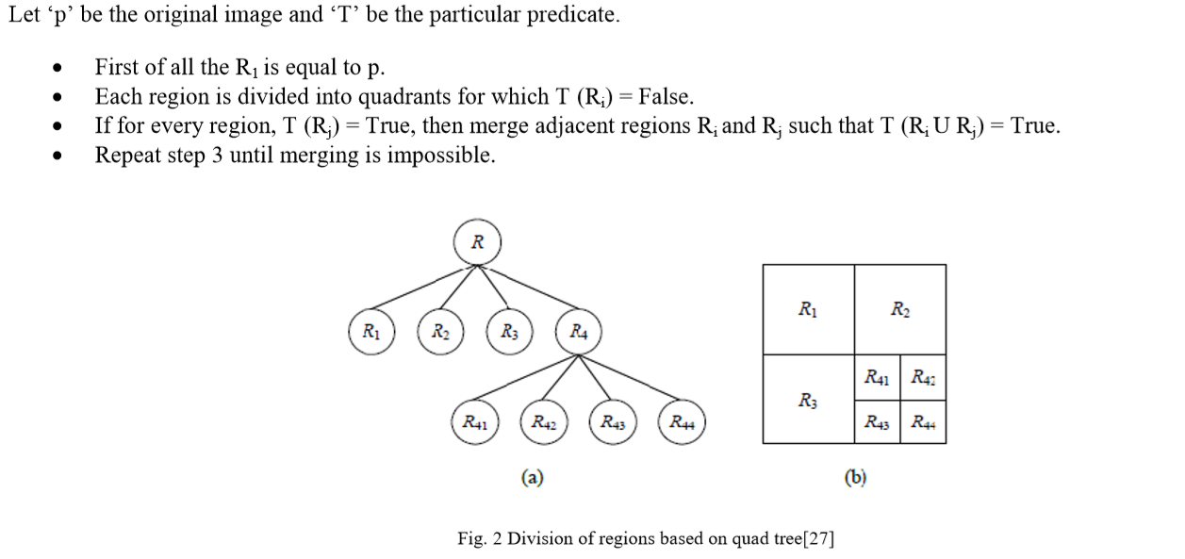

Slide 18
Active contour segmentation
Active contour is a type of segmentation technique which can be defined as use of energy forces and constraints for segregation of the pixels of interest from the image for further processing and analysis. Active contour described as active model for the process of segmentation.
Contours are boundaries designed for the area of interest required in an image. Contour is a collection of points that undergoes interpolation process.
The main application of active contours in image processing is to define smooth shape in the image and forms closed contour for the region

Slide 19
The advantages of using the active object segmentation contour model include Smooth and closed contours for identification of defects, Identification of weak defect borders, Reasonable accuracy, Reasonable processing time, Easy formulation. Active contours are used for segmentation of artifacts and identification of boundaries.

Slide 20
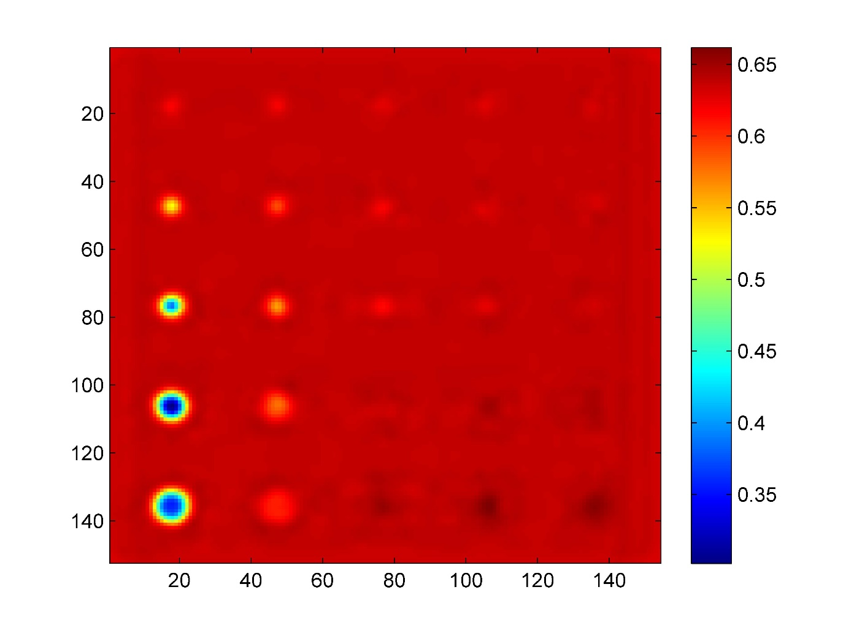

Slide 21
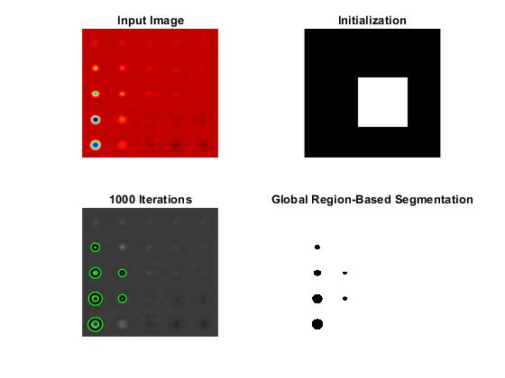
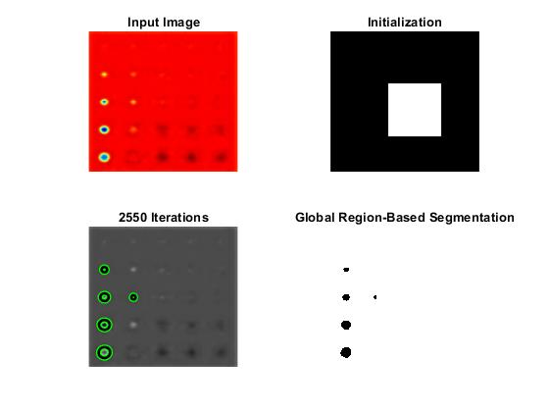
Results

Slide 22
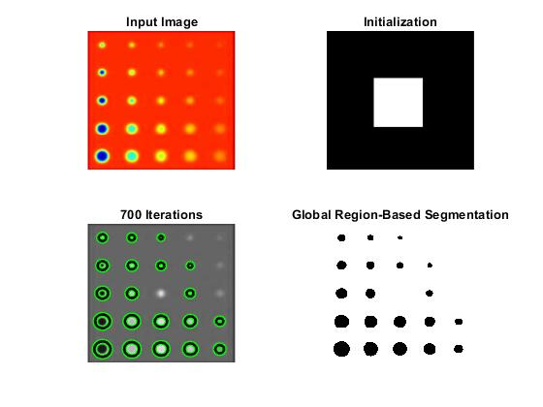

Slide 23
Video Segmentation
saliency object detection
Detecting and segmenting salient objects from natural scenes, often referred to as salient object detection, has attracted great interest in computer vision. While many models have been proposed and several applications have emerged, a deep understanding of achievements and issues remains lacking. We aim to provide a comprehensive review of recent progress in salient object detection and situate this field among other closely related areas such as generic scene segmentation, object proposal generation, and saliency for fixation prediction. Covering 228 publications, we survey i) roots, key concepts, and tasks, ii) core techniques and main modeling trends, and iii) datasets and evaluation metrics for salient object detection. We also discuss open problems such as evaluation metrics and dataset bias in model performance, and suggest future research directions.

Slide 24
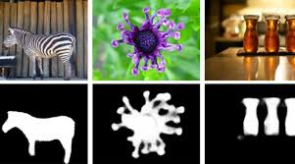

Slide 25
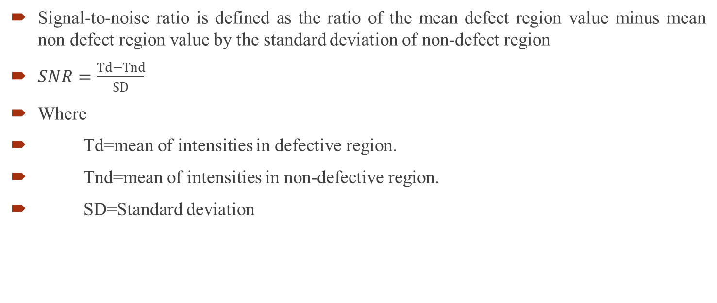
^{SNR (Signal to Noise Ratio): -}
Signal-to-noise ratio is defined as the ratio of the mean defect region value minus mean non defect region value by the standard deviation of non-defect region
$SNR=\frac{Td−Tnd}{SD}$
Where
Td=mean of intensities in defective region.
Tnd=mean of intensities in non-defective region.
SD=Standard deviation

Slide 26
